Slide 1


Chapter 6
DESIGN UI
Syaeful Anas Aklani, M.Kom
Prodi Sistem Informasi
Universitas Internasional Batam

Slide 2
Design Form
Instal aplication
Xampp
Mysqlconnector.Net
Visual Studio

Slide 3
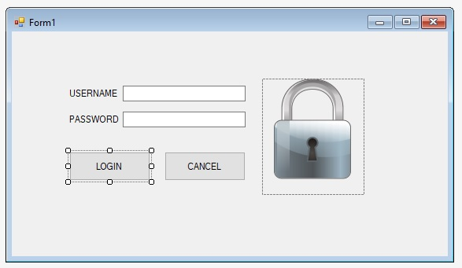
Design Form

Slide 4
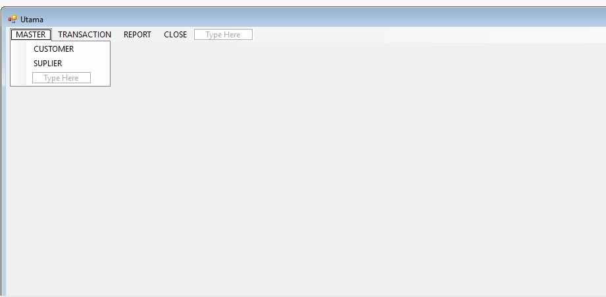
Design Form

Slide 5
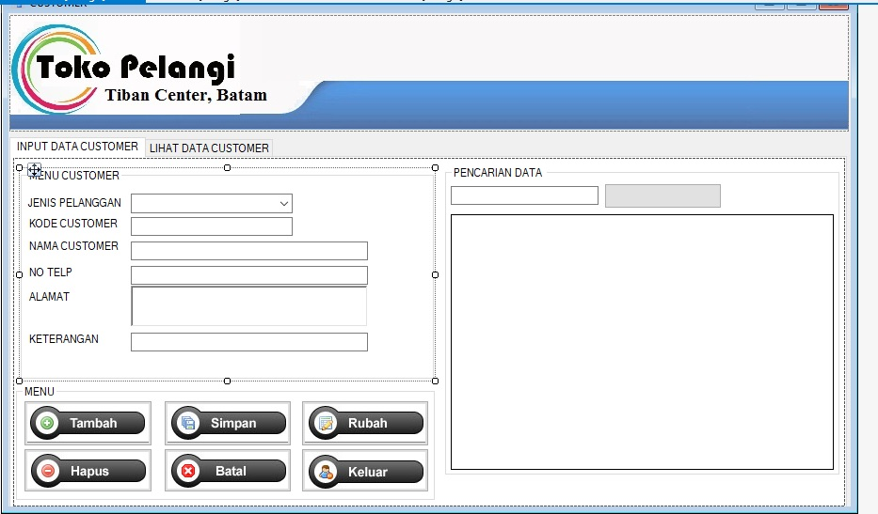
Design Form

Slide 6
Design Form
using System;
using System.Collections.Generic;
using System.ComponentModel;
using System.Data;
using System.Drawing;
using System.Linq;
using System.Text;
using System.Threading.Tasks;
using System.Windows.Forms;
using MySql.Data.MySqlClient;

Slide 7
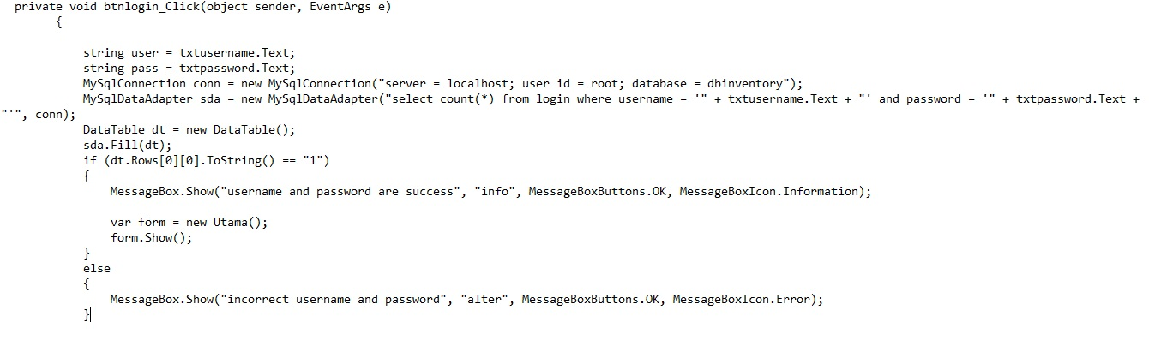
Design Form

